Slide 1
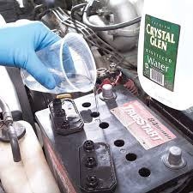
Battery maintenance

Slide 2
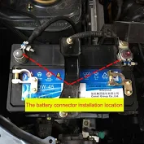
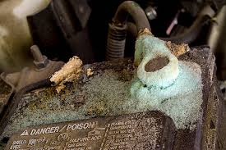
Step 1. Check that the battery terminals are tight
- If its loose, tightening the terminals with a spanner.
Step 2. Check if there’s no corrosion on terminals (free of acids)
- If terminals are dirty, remove the acids with warm water.

Slide 3
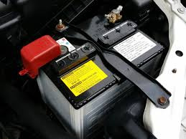
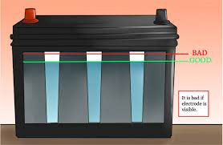
Step 3: Check battery for hold down clamp/ bracket.
- If the bracket or hold down clamp is loose, use a spanner to tighten them.
Step 4: Check battery acid level.
-If its low, top-up.

Slide 4
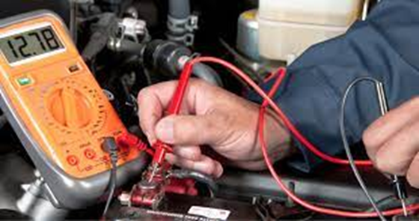
Step 5: Always maintain that the battery level is 12.5V.
- If the reading is below 12.5V, visit the battery center for further testing.
Feedback
Activity : Worksheet 3
Kwa Thema Skills School
Subject : Maintenance Marks :10
Grade : Year 2 Time : 30mins
Date :

Slide 5
Question :1
1. Name five steps of battery maintenance and its purpose.
1.1 Stage 1 :(a) ______________________________________________
:(b) ______________________________________________
1.2 Stage 2 :(a) ______________________________________________
:(b) ______________________________________________
1.3 Stage 3 :(a) ______________________________________________
:(b) ______________________________________________
1.4 Stage 4 :(a) ______________________________________________
:(b) ______________________________________________
1.5 Stage 5 :(a) ______________________________________________
:(b) ______________________________________________

